Slide 1
CONTINUOUS TOP-K DOMINATING QUERIES
Maria Kontaki, Apostolos N, Yannis Manolopoulos

Slide 2
TOP-K Queries
Ranking func is is required, assign a val to each point.
The result of top-k query comprises the k points with the highest value with respect to f().
The number of answers is controlled by the parameter k, although in some cases the cardinality of the result set may exceed k due to ties (i.e., two or more points may have the same value.)
Ranking function is required. This function is usually user-defined, whereas different functions generally result in different results.

Slide 3
Skyline Queries
Do not require a ranking function and they have the scaling invariance property.
The result of a skyline query is composed of the points that are not dominated by any other point.
In some cases small values are preferable (e.g., price) whereas in other cases large values are desirable (e.g., quality). Without loss of generality, we focus on minimizing dimension values (the smaller the better). Therefore, a point p dominates another point q (p ≺ q), if and only if p is no worse than q in all dimensions and strictly better than q in at least one dimension.

Slide 4
Top-K Domininating Queries
It uses a ranking function to rank points (as in top-k queries) and it uses the dominance relationship (as in skyline queries).
Properties:
the number of results is controllable,
the result is scaling invariant,
no user-defined rank- ing function is required, and
each point is assigned an intuitive score which determines its rank.

Slide 5
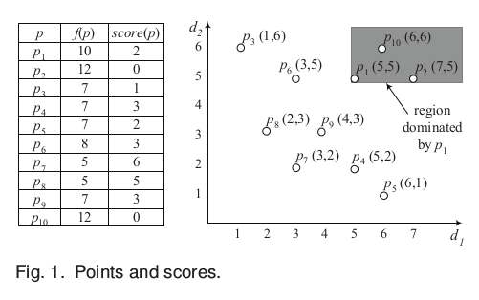
The skyline set comprises all points that are not dominated. These points are p 3 , p 8 , p 7 and p 5 . Let f (p) = p.x + p.y be a monotonically increasing ranking function. An example top-k query could ask for the k = 2 points with the best (lowest) rank. In this case, the preferred points are p 7 and p 8 . Finally, a top- 3 dominating query would return p 7 , p 8 and p 6, since these points provide the highest domination score (the number of points they dominate is the largest).

Slide 6
Related Work
Fagin’s pioneering work → design algorithms that operate under the assumption that the values in each dimension can be provided in sorted order.
[25] Efficient branch-and-bound skyline query processing scheme → which utilizes the R-tree index [10] and shows significant performance improvements over previously proposed methods.
K-dominant skylines [5] → relax the definition of dominance, to allow some points to be dominated → reducing the cardinality of the skyline set.

Slide 7
Related Work
Variation of skyline queries, the representative skyline
[18] Selecting skyline points according to their domination capabilities.
Ranking of objects according to their domination power
Efficient algorithms to determine the top-k dominating points by using an aggregate R-tree index.
Method is studied to rank and cluster multidimensional points according to their domination power
Efficient algorithms for top-k dominating query processing in uncertain databases.
Reverse top-k query
Incremental evaluation of top-k dominating queries
The concept of dominance score has been also used in [27] to rank web services based on multiple criteria.

Slide 8
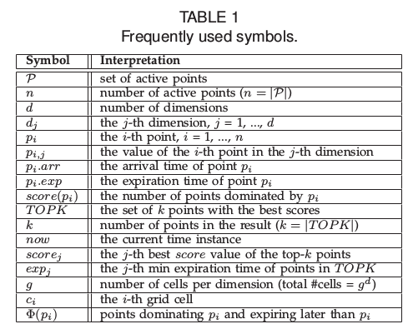
Background
Problem Definition: Given a dynamic data stream containing n active points p 1 , ..., p n , where p i ∈ Rd and n is the sliding window size, monitor the k points with the highest domination score continuously.
Count-based sliding window → the number of active points remains constant, and if r new points arrive the r oldest expire.
Time-based sliding window → the number of active points may not be constant. The expiration time of a point does not depend on the arrival or expiration of other points.

Slide 9
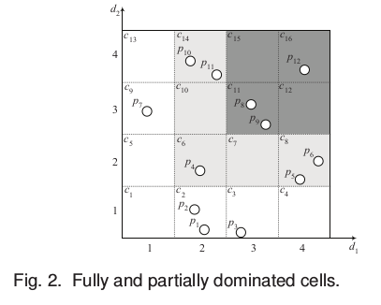
Background
Cell c 6 in Figure 2 dominates cells c 11 , c 12 , c 15 and c 16 . These cells are called fully dominated cells or simply dominated cells.
Cells c 6 , c 7 , c 8 , c 10 and c 14 may contain points that are dominated by a point in c 6 . These cells are called partially dominated cells
Compute a score(p i) → count the number of points dominated by p i
p 4 dominates p 6 and p 11 which reside in partially dominated cells. Moreover, there are 3 points (p 8 , p 9 and p 12 ) in the fully dominated cells. Therefore, the total score of p 4 is score(p 4 ) = 2 + 3 = 5. This process is called exact score computation and it is the most time consuming task.

Slide 10
Background
The naı̈ve approach to evaluate a top-k dominating query continuously → to perform all domination checks among points.
More specifically, for a new point p x , its score score(p x ) is computed by counting the number of points dominated by p x .
Moreover, the score of a point p y , y != x should be increased if p y dominates p x . When a point expires, the scores of other points need to be updated.
We call this simple algorithm BFA (Brute-Force Algorithm). It is expected that BFA will invoke a large number (O(n)) of domination checks between points.

Slide 11
Event-Based Processing
Event-based algorithm (EVA) which uses event scheduling and rescheduling towards avoiding the examination of points for inclusion in TOP K.
p i can be part of T OP K in each update:
if a point in T OP K expires or
if the score of p i becomes larger than or equal to score k .

Slide 12
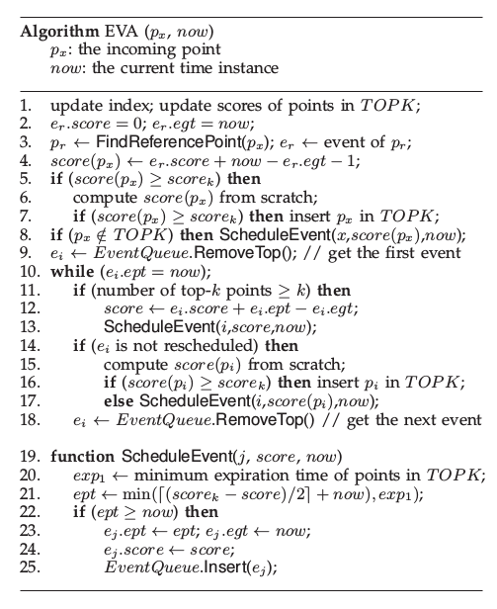
Outline EVA

Slide 13
Event based proccessing
Upper bounding scores of existing points
Upper bounding scores of incoming points
Outline of EVA

Slide 14
Advanced Algorithm
EVA limitation
All points that are not part of T OP K, should be examined at the expiration time of a top-k dominating point.
Possible that many points have a score close to score k , resulting in consecutive exact score computations.
ADA (ADvanced Algorithm).
Advanced Event Time Computation
Using Candidates Points
Continuously evaluate the score of some special points called candidate points, whose event processing time is in the near future.

Slide 15
Approximate Solutions
By using an approximation, a more realistic value (closer to the exact score) may be computed, speeding up query execution and, on the other hand, possibly sacrificing the accuracy of the result.
The key idea is to maintain a random sample of points in a cell and compute their mean score.
This value is used as an approximation for the score of any other point of this particular cell.
The sample size should be large enough so as to guarantee that the estimated score will not be very far from the true mean.
AHBA (Approximate Hoeffding Bound Algorithm)

Slide 16
Approximate Solutions
By assuming that the data distribution does not change rapidly, it is possible to ignore some points by excluding them from the event generation mechanism.
(By assuming that data distribution does not change significantly). Let minscore(c j ) denote the smallest possible score of all points contained in cell c j . All points belonging to c j are excluded from event processing if score 1 − score k < score k −minscore(c j ). This algorithm, denoted as AMSA (Approximate Minimum Score Algorithm), uses an aggressive heuristic-based technique to speed-up processing, but it does not provide any guarantees regarding accuracy.

Slide 17
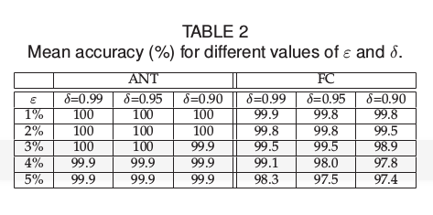
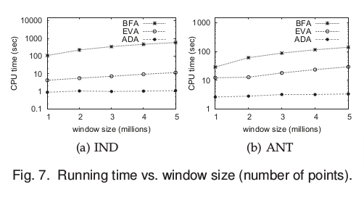
Performance Evaluation

Slide 18
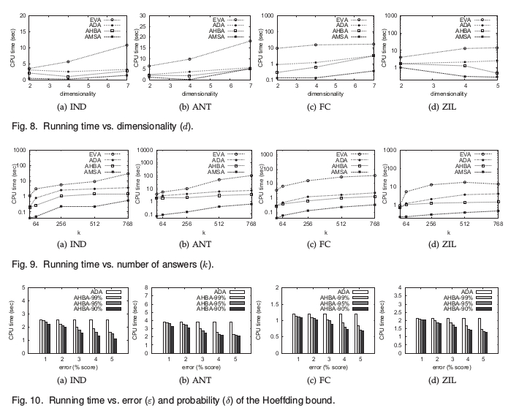

Slide 19
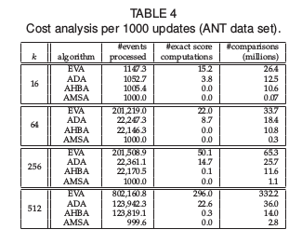
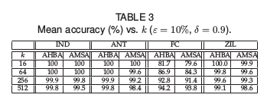
Performance Evaluation

Slide 20
Conclusion
Top-k dominating queries → an intuitive ranking function is used, the result is bounded by k.
ADA shows the best overall performance.
AHBA and AMSA, which sacrifice accuracy for faster computation.
AHBA is based on sampling and offers probabilistic guarantees regarding the approximation error. On the other hand, AMSA is based on event pruning leading to faster processing with less accuracy compared to AHBA.
Strict accuracy → ADA
In case a heavy system load is detected and accuracy may be compromised (but within limits) → AHBA
Fast solution → AMSA.

Slide 21
THANKS!
CONTINUOUS TOP-K DOMINATING QUERIES Maria Kontaki, Apostolos N, Yannis Manolopoulos

Slide 22
CONTINUOUS TOP-K DOMINATING QUERIES on DISTRIBUTED DATA
PROBLEM:
Given a dynamic distributed data stream containing n active points p1, …, pn, where pi E Rd and n is the sliding window size.
Monitor the k points with the highest domination score continuously.

Slide 23
CONTINUOUS TOP-K DOMINATING QUERIES ON DISTRIBUTED DATA
Sliding Windows → Count Based
Grid Based Indexing
Domination Score
BFA
EVA
(Upper-Bounding Scores of Existing Points
Upper-Bounding Scores of Incoming Points)
→ ADA
Advanced Time Computation
Using Candidates Points
Evicting Obsolete Events
DISTRIBUTED DATA
Routing Mechanism Construction Phase
Pre-processing phase where super-peers gather some carefully selected data from their peers.
Thereafter, at query processing time, a super-peer can execute the query over its locally aggregated data and retrieve the fraction of the top-k query result that corresponds to its peers.

Slide 24
JUDUL: PENGOLAHAN TOP-K DOMINATING QUERIES PADA DATA STREAMING TERDISTRIBUSI

